Slide 1
Accelerating Systems with Programmable Logic Components Lecture 12 Neural network II Part 1
1DT109 ASPLOC
2022 VT1-VT2
Yuan Yao, yuan.yao@it.uu.se

Slide 2
Agenda
A brief introduction to backpropagation
Notations
Preparatory concepts
Backpropagation
Corollary 1

Slide 3
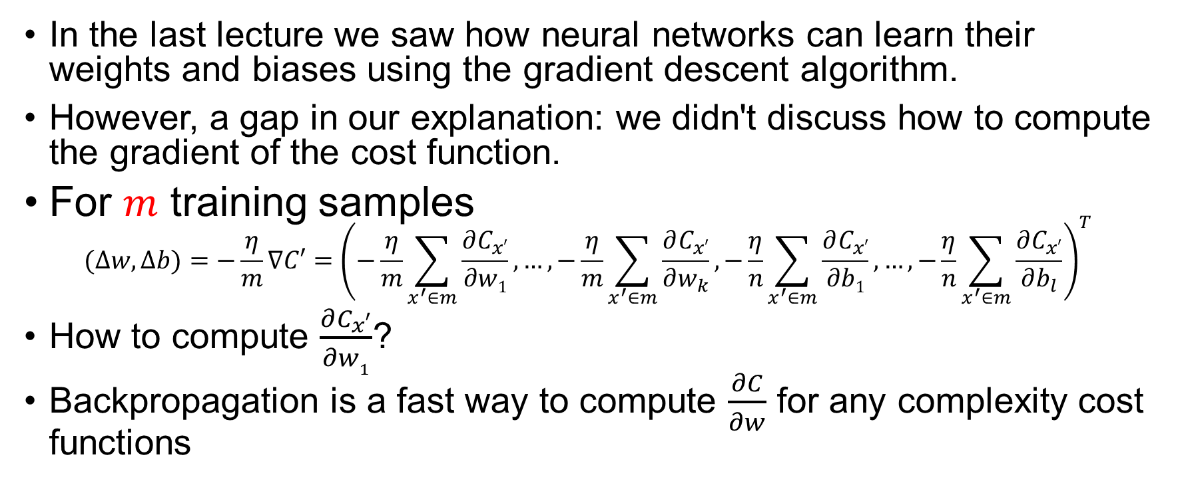
Backpropagation
In the last lecture we saw how neural networks can learn their weights and biases using the gradient descent algorithm.
However, a gap in our explanation: we didn't discuss how to compute the gradient of the cost function.
For $m$ training samples $(∆w,∆b)=−\frac{η}{m}∇C′={\left(−\frac{η}{m}\sum_{x^{′}∈m}{\frac{∂C_{x′}}{∂w1}},…,−\frac{η}{m}\sum_{x^{′}∈m}{\frac{∂C_{x′}}{∂w_{k}}},−\frac{η}{n}\sum_{x^{′}∈m}{\frac{∂C_{x′}}{∂b1}},…,−\frac{η}{n}\sum_{x^{′}∈m}{\frac{∂C_{x′}}{∂b_{l}}}\right)}^{T}$
How to compute $\frac{∂C_{x′}}{∂w1}$?
Backpropagation is a fast way to compute $\frac{∂C}{∂w}$ for any complexity cost functions

Slide 4
Backpropagation – a brief history
The backpropagation algorithm was originally introduced in the 1970s.
Fully appreciated by David Rumelhart, Geoffrey Hinton, and Ronald Williams in the paper:
David Rumelhart, Geoffrey Hinton, Ronald William, “Learning representations by back-propagating errors,” in Nature, vol 323, issue 9, 533-536, 1986.
Abstract: The paper describes several neural networks where backpropagation works far faster than earlier approaches to learning, making it possible to use neural nets to solve problems which had previously been insoluble.
Today, the backpropagation algorithm is the workhorse of learning in neural networks.
Remember that the derivative of the cost function determines how (fast) a NN learns.

Slide 5
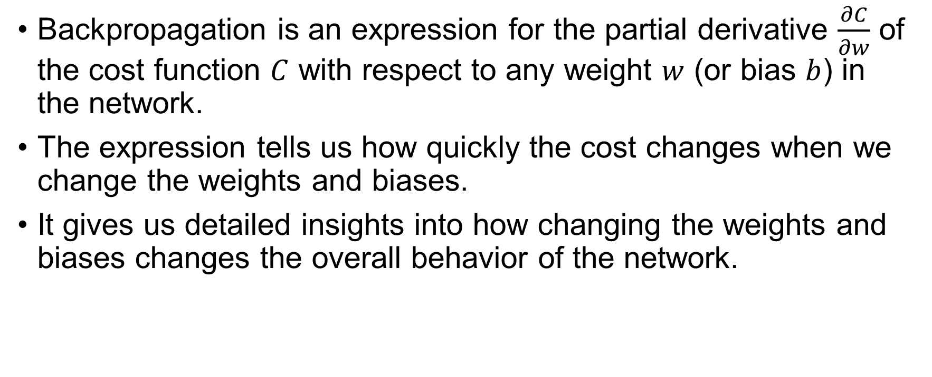
Backpropagation
Backpropagation is an expression for the partial derivative $\frac{∂C}{∂w}$ of the cost function $C$ with respect to any weight $w$ (or bias $b$) in the network.
The expression tells us how quickly the cost changes when we change the weights and biases.
It gives us detailed insights into how changing the weights and biases changes the overall behavior of the network.

Slide 6


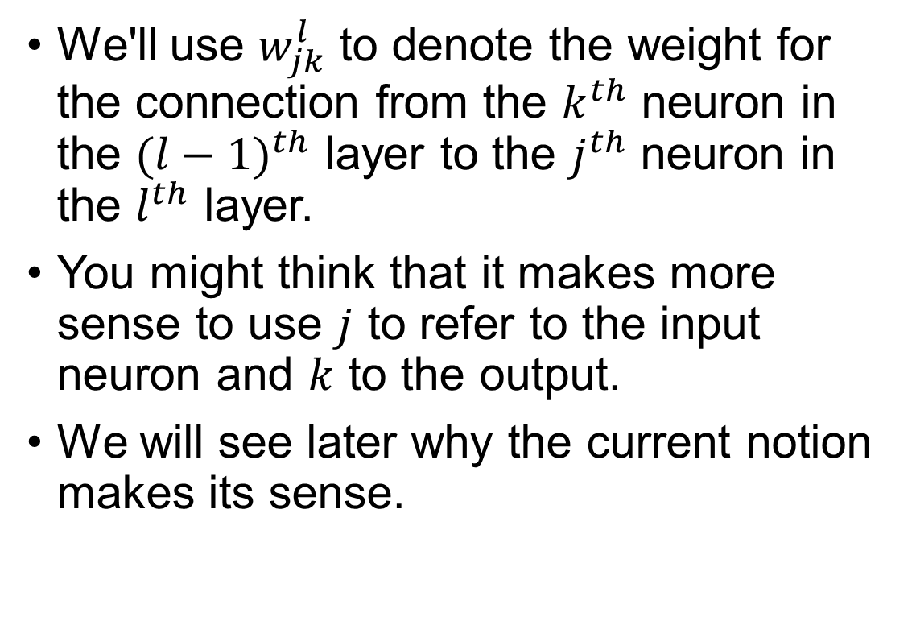


Notations
We'll use $w_{jk}^{l}$ to denote the weight for the connection from the $k^{th}$ neuron in the ${(l−1)}^{th}$ layer to the $j^{th}$ neuron in the $l^{th}$ layer.
You might think that it makes more sense to use $j$ to refer to the input neuron and $k$ to the output.
We will see later why the current notion makes its sense.
$$l$$
$$w_{24}^{3}$$
$$j$$
$$k$$

Slide 7
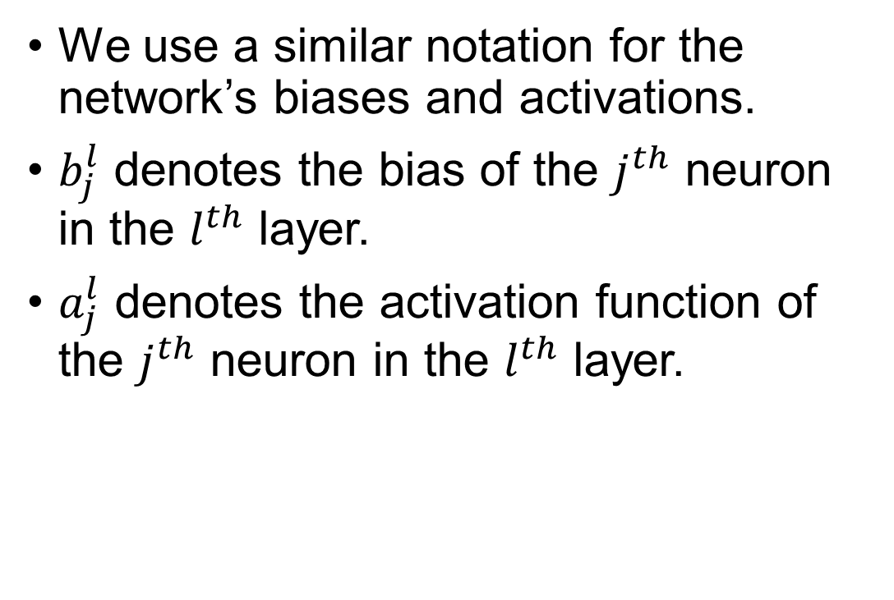


Notations
We use a similar notation for the network’s biases and activations.
$b_{j}^{l}$ denotes the bias of the $j^{th}$ neuron in the $l^{th}$ layer.
$a_{j}^{l}$ denotes the activation function of the $j^{th}$ neuron in the $l^{th}$ layer.
$$a_{1}^{3}$$
$$b_{3}^{2}$$

Slide 8
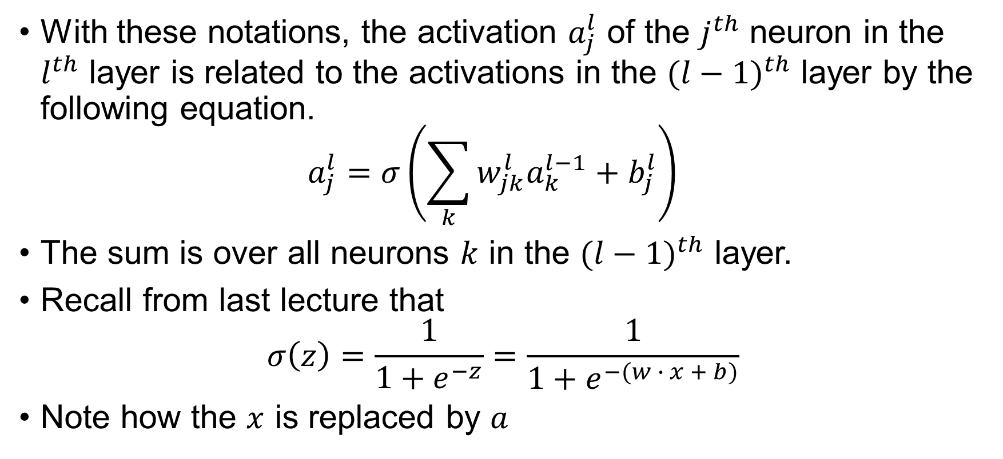
Notations
With these notations, the activation $a_{j}^{l}$ of the $j^{th}$ neuron in the $l^{th}$ layer is related to the activations in the ${(l−1)}^{th}$ layer by the following equation. $a_{j}^{l}=σ\left(\sum_{k}{w_{jk}^{l}a_{k}^{l−1}}+b_{j}^{l}\right)$
The sum is over all neurons $k$ in the ${(l−1)}^{th}$ layer.
Recall from last lecture that $σ\left(z\right)=\frac{1}{1+e^{−z}}=\frac{1}{1+e^{−(w ∙ x + b)}}$
Note how the $x$ is replaced by $a$

Slide 9
Preparations
Before we heading into how backpropagation works, we need to know 3 concepts
How to model an NN using matrix
What kind of cost function can be applied with backpropagation
The Hadamard product

Slide 10








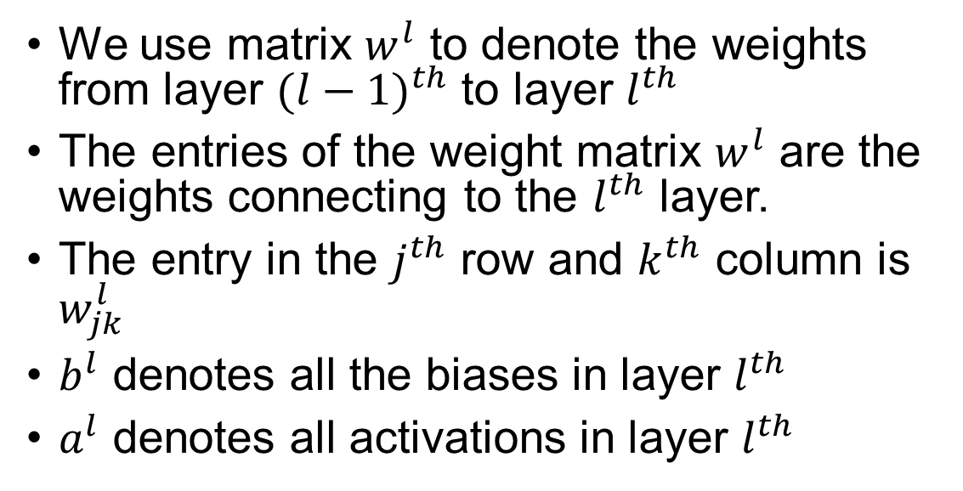

































P1: a matrix-based approach to represent a neural network
We use matrix $w^{l}$ to denote the weights from layer ${(l−1)}^{th}$ to layer $l^{th}$
The entries of the weight matrix $w^{l}$ are the weights connecting to the $l^{th}$ layer.
The entry in the $j^{th}$ row and $k^{th}$ column is $w_{jk}^{l}$
$b^{l}$ denotes all the biases in layer $l^{th}$
$a^{l}$ denotes all activations in layer $l^{th}$
$$w_{11}^{2}$$
$$w_{12}^{2}$$
$$a_{1}^{2},b_{1}^{2}$$
$$w_{13}^{2}$$
$$a_{1}^{1}$$
$$w_{21}^{2}$$
$$w_{22}^{2}$$
$$a_{2}^{2},b_{2}^{2}$$
$$w_{23}^{2}$$
$$a_{2}^{1}$$
$$w_{31}^{2}$$
$$w_{32}^{2}$$
$$a_{3}^{2},b_{3}^{2}$$
$$w_{11}^{2}$$
$$w_{12}^{2}$$
$$w_{13}^{2}$$
$$b_{1}^{2}$$
$$w_{33}^{2}$$
$$a_{1}^{1}$$
$$w_{41}^{2}$$
$$w_{21}^{2}$$
$$w_{22}^{2}$$
$$w_{23}^{2}$$
$$b_{2}^{2}$$
$$a_{3}^{1}$$
$$w^{2}=$$
$a^{1}=$
$$a_{2}^{1}$$
$b^{2}=$
$$w_{42}^{2}$$
$$w_{31}^{2}$$
$$w_{32}^{2}$$
$$w_{33}^{2}$$
$$b_{3}^{2}$$
$$a_{4}^{2},b_{4}^{2}$$
$$a_{3}^{1}$$
$$w_{43}^{2}$$
$$w_{41}^{2}$$
$$w_{42}^{2}$$
$$w_{43}^{2}$$
$$b_{4}^{2}$$

Slide 11















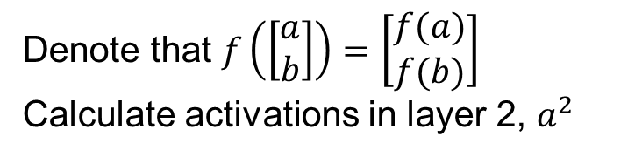


















P1: a matrix-based approach to represent a neural network
$$w_{11}^{2}$$
$$w_{12}^{2}$$
$$w_{13}^{2}$$
$$b_{1}^{2}$$
$$w_{11}^{2}$$
$$a_{1}^{1}$$
$$w_{21}^{2}$$
$$w_{22}^{2}$$
$$w_{23}^{2}$$
$$b_{2}^{2}$$
$$w_{12}^{2}$$
$$a_{1}^{2},b_{1}^{2}$$
$$w^{2}=$$
$a^{1}=$
$$a_{2}^{1}$$
$b^{2}=$
$$w_{31}^{2}$$
$$w_{32}^{2}$$
$$w_{33}^{2}$$
$$b_{3}^{2}$$
$$w_{13}^{2}$$
$$a_{3}^{1}$$
$$w_{41}^{2}$$
$$w_{42}^{2}$$
$$w_{43}^{2}$$
$$b_{4}^{2}$$
$$a_{1}^{1}$$
$$w_{21}^{2}$$
$$w_{22}^{2}$$
$$a_{2}^{2},b_{2}^{2}$$
Denote that $f\left(\left[\begin{matrix}a \\ b\end{matrix}\right]\right)=\left[\begin{matrix}f(a) \\ f(b)\end{matrix}\right]$
Calculate activations in layer 2, $a^{2}$
$$w_{23}^{2}$$
$$a_{2}^{1}$$
$$w_{31}^{2}$$
$$w_{32}^{2}$$
$$a_{3}^{2},b_{3}^{2}$$
(
)
$$a_{1}^{1}$$
$$w_{33}^{2}$$
$$σ$$
$$a_{1}^{2}=$$
$$w_{11}^{2}$$
$$w_{12}^{2}$$
$$w_{13}^{2}$$
$$×$$
$$a_{2}^{1}$$
$$+$$
$$b_{1}^{2}$$
$$w_{41}^{2}$$
$$a_{3}^{1}$$
$$a_{3}^{1}$$
$$w_{42}^{2}$$
$$a_{4}^{2},b_{4}^{2}$$
$$w_{43}^{2}$$

Slide 12





P1: a matrix-based approach to represent a neural network
$$w_{11}^{2}$$
$$w_{12}^{2}$$
$$w_{13}^{2}$$
$$b_{1}^{2}$$
$$w_{11}^{2}$$
$$a_{1}^{1}$$
$$w_{21}^{2}$$
$$w_{22}^{2}$$
$$w_{23}^{2}$$
$$b_{2}^{2}$$
$$w_{12}^{2}$$
$$a_{1}^{2},b_{1}^{2}$$
$$w^{2}=$$
$a^{1}=$
$$a_{2}^{1}$$
$b^{2}=$
$$w_{31}^{2}$$
$$w_{32}^{2}$$
$$w_{33}^{2}$$
$$b_{3}^{2}$$
$$w_{13}^{2}$$
$$a_{3}^{1}$$
$$w_{41}^{2}$$
$$w_{42}^{2}$$
$$w_{43}^{2}$$
$$b_{4}^{2}$$
$$a_{1}^{1}$$
$$w_{21}^{2}$$
$$w_{22}^{2}$$
$$a_{2}^{2},b_{2}^{2}$$
Denote that $f\left(\left[\begin{matrix}a \\ b\end{matrix}\right]\right)=\left[\begin{matrix}f(a) \\ f(b)\end{matrix}\right]$
Calculate activations in layer 2, $a^{2}$
$$w_{23}^{2}$$
$$a_{2}^{1}$$
$$w_{31}^{2}$$
$$w_{32}^{2}$$
$$a_{3}^{2},b_{3}^{2}$$
(
)
$$a_{1}^{1}$$
$$w_{33}^{2}$$
$$σ$$
$$a_{2}^{2}=$$
$$w_{21}^{2}$$
$$w_{22}^{2}$$
$$w_{23}^{2}$$
$$×$$
$$a_{2}^{1}$$
$$+$$
$$b_{2}^{2}$$
$$w_{41}^{2}$$
$$a_{3}^{1}$$
$$a_{3}^{1}$$
$$w_{42}^{2}$$
$$a_{4}^{2},b_{4}^{2}$$
$$w_{43}^{2}$$

Slide 13





P1: a matrix-based approach to represent a neural network
$$w_{11}^{2}$$
$$w_{12}^{2}$$
$$w_{13}^{2}$$
$$b_{1}^{2}$$
$$w_{11}^{2}$$
$$a_{1}^{1}$$
$$w_{21}^{2}$$
$$w_{22}^{2}$$
$$w_{23}^{2}$$
$$b_{2}^{2}$$
$$w_{12}^{2}$$
$$a_{1}^{2},b_{1}^{2}$$
$$w^{2}=$$
$a^{1}=$
$$a_{2}^{1}$$
$b^{2}=$
$$w_{31}^{2}$$
$$w_{32}^{2}$$
$$w_{33}^{2}$$
$$b_{3}^{2}$$
$$w_{13}^{2}$$
$$a_{3}^{1}$$
$$w_{41}^{2}$$
$$w_{42}^{2}$$
$$w_{43}^{2}$$
$$b_{4}^{2}$$
$$a_{1}^{1}$$
$$w_{21}^{2}$$
$$w_{22}^{2}$$
$$a_{2}^{2},b_{2}^{2}$$
Denote that $f\left(\left[\begin{matrix}a \\ b\end{matrix}\right]\right)=\left[\begin{matrix}f(a) \\ f(b)\end{matrix}\right]$
Calculate activations in layer 2, $a^{2}$
$$w_{23}^{2}$$
$$a_{2}^{1}$$
$$w_{31}^{2}$$
$$w_{32}^{2}$$
$$a_{3}^{2},b_{3}^{2}$$
(
)
$$a_{1}^{1}$$
$$w_{33}^{2}$$
$$σ$$
$$a_{3}^{2}=$$
$$w_{31}^{2}$$
$$w_{32}^{2}$$
$$w_{33}^{2}$$
$$×$$
$$a_{2}^{1}$$
$$+$$
$$b_{3}^{2}$$
$$w_{41}^{2}$$
$$a_{3}^{1}$$
$$a_{3}^{1}$$
$$w_{42}^{2}$$
$$a_{4}^{2},b_{4}^{2}$$
$$w_{43}^{2}$$

Slide 14





P1: a matrix-based approach to represent a neural network
$$w_{11}^{2}$$
$$w_{12}^{2}$$
$$w_{13}^{2}$$
$$b_{1}^{2}$$
$$w_{11}^{2}$$
$$a_{1}^{1}$$
$$w_{21}^{2}$$
$$w_{22}^{2}$$
$$w_{23}^{2}$$
$$b_{2}^{2}$$
$$w_{12}^{2}$$
$$a_{1}^{2},b_{1}^{2}$$
$$w^{2}=$$
$a^{1}=$
$$a_{2}^{1}$$
$b^{2}=$
$$w_{31}^{2}$$
$$w_{32}^{2}$$
$$w_{33}^{2}$$
$$b_{3}^{2}$$
$$w_{13}^{2}$$
$$a_{3}^{1}$$
$$w_{41}^{2}$$
$$w_{42}^{2}$$
$$w_{43}^{2}$$
$$b_{4}^{2}$$
$$a_{1}^{1}$$
$$w_{21}^{2}$$
$$w_{22}^{2}$$
$$a_{2}^{2},b_{2}^{2}$$
Denote that $f\left(\left[\begin{matrix}a \\ b\end{matrix}\right]\right)=\left[\begin{matrix}f(a) \\ f(b)\end{matrix}\right]$
Calculate activations in layer 2, $a^{2}$
$$w_{23}^{2}$$
$$a_{2}^{1}$$
$$w_{31}^{2}$$
$$w_{32}^{2}$$
$$a_{3}^{2},b_{3}^{2}$$
(
)
$$a_{1}^{1}$$
$$w_{33}^{2}$$
$$σ$$
$$a_{4}^{2}=$$
$$w_{41}^{2}$$
$$w_{42}^{2}$$
$$w_{43}^{2}$$
$$×$$
$$a_{2}^{1}$$
$$+$$
$$b_{4}^{2}$$
$$w_{41}^{2}$$
$$a_{3}^{1}$$
$$a_{3}^{1}$$
$$w_{42}^{2}$$
$$a_{4}^{2},b_{4}^{2}$$
$$w_{43}^{2}$$

Slide 15
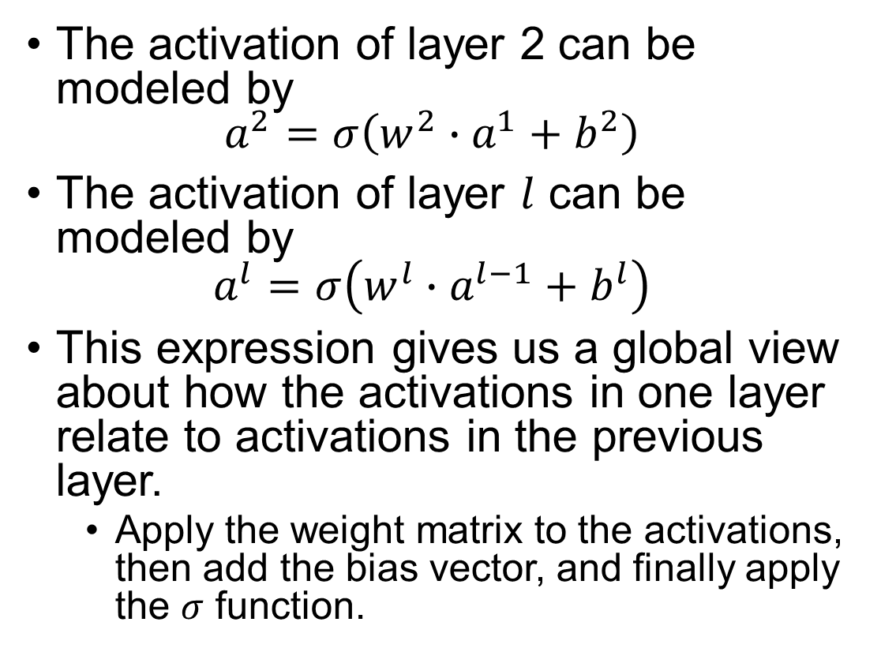

Summarizing it up
The activation of layer 2 can be modeled by $a^{2}=σ\left(w^{2}∙a^{1}+b^{2}\right)$
The activation of layer $l$ can be modeled by $a^{l}=σ\left(w^{l}∙a^{l−1}+b^{l}\right)$
This expression gives us a global view about how the activations in one layer relate to activations in the previous layer.
Apply the weight matrix to the activations, then add the bias vector, and finally apply the $σ$ function.
$$w_{11}^{2}$$
$$w_{12}^{2}$$
$$a_{1}^{2},b_{1}^{2}$$
$$w_{13}^{2}$$
Why $w_{jk}^{l}$ is a better notation than $w_{kj}^{l}$?
Avoiding tranpose of the weight matrix!
$$a_{1}^{1}$$
$$w_{21}^{2}$$
$$w_{22}^{2}$$
$$a_{2}^{2},b_{2}^{2}$$
$$w_{23}^{2}$$
$$a_{2}^{1}$$
$$w_{31}^{2}$$
$$w_{32}^{2}$$
$$a_{3}^{2},b_{3}^{2}$$
$$w_{33}^{2}$$
$$a_{3}^{1}$$
$$w_{41}^{2}$$
$$w_{42}^{2}$$
$$a_{4}^{2},b_{4}^{2}$$
$$w_{43}^{2}$$

Slide 16

Summarizing it up
We can assign $z^{l}=w^{l}∙a^{l−1}+b^{l}$
Thus $a^{l}=σ\left(w^{l}∙a^{l−1}+b^{l}\right)=σ\left(z^{l}\right)$
Also note that $z_{j}^{l}=\sum_{k}{w_{jk}^{l}a_{k}^{l−1}}+b_{j}^{l}$

Slide 17
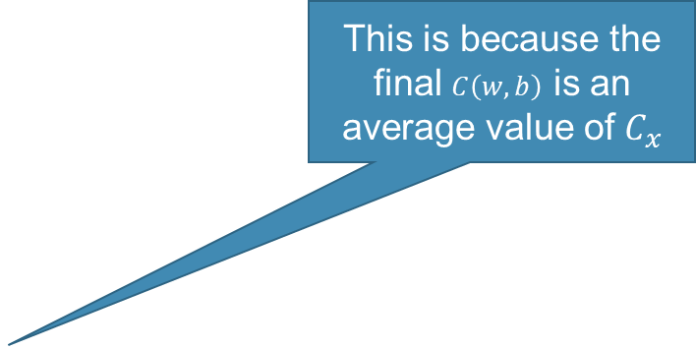
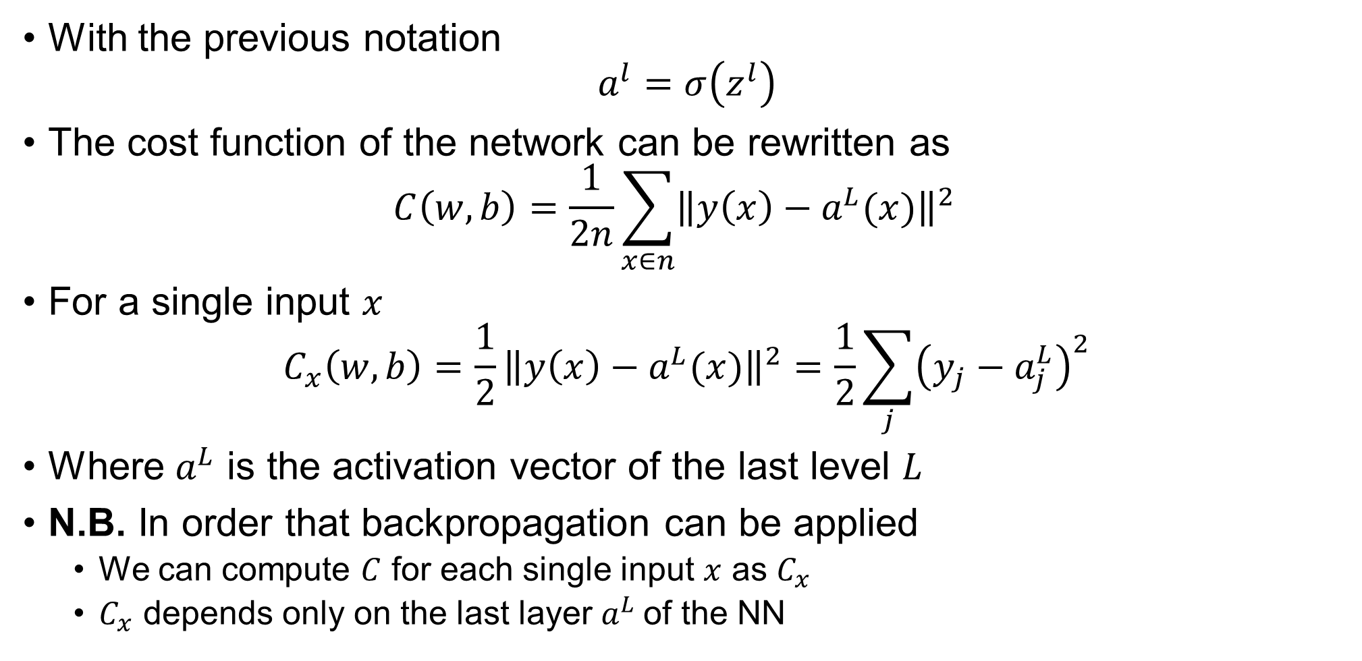
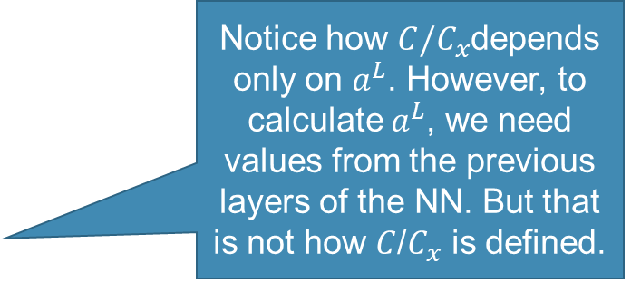
P2: assumptions of the cost function
With the previous notation $a^{l}=σ\left(z^{l}\right)$
The cost function of the network can be rewritten as $C\left(w, b\right)=\frac{1}{2n}\sum_{x∈n}{{\left\|y\left(x\right)−a^{L}(x)\right\|}^{2}}$
For a single input $x$ $C_{x}\left(w, b\right)=\frac{1}{2}{\left\|y\left(x\right)−a^{L}(x)\right\|}^{2}=\frac{1}{2}\sum_{j}{{\left(y_{j}−a_{j}^{L}\right)}^{2}}$
Where $a^{L}$ is the activation vector of the last level $L$
N.B. In order that backpropagation can be applied
We can compute $C$ for each single input $x$ as $C_{x}$
$C_{x}$ depends only on the last layer $a^{L}$of the NN
This is because the final $C\left(w, b\right)$ is an average value of $C_{x}$
Notice how $C/C_{x}$depends only on $a^{L}$. However, to calculate $a^{L}$, we need values from the previous layers of the NN. But that is not how $C$/$C_{x}$ is defined.

Slide 18
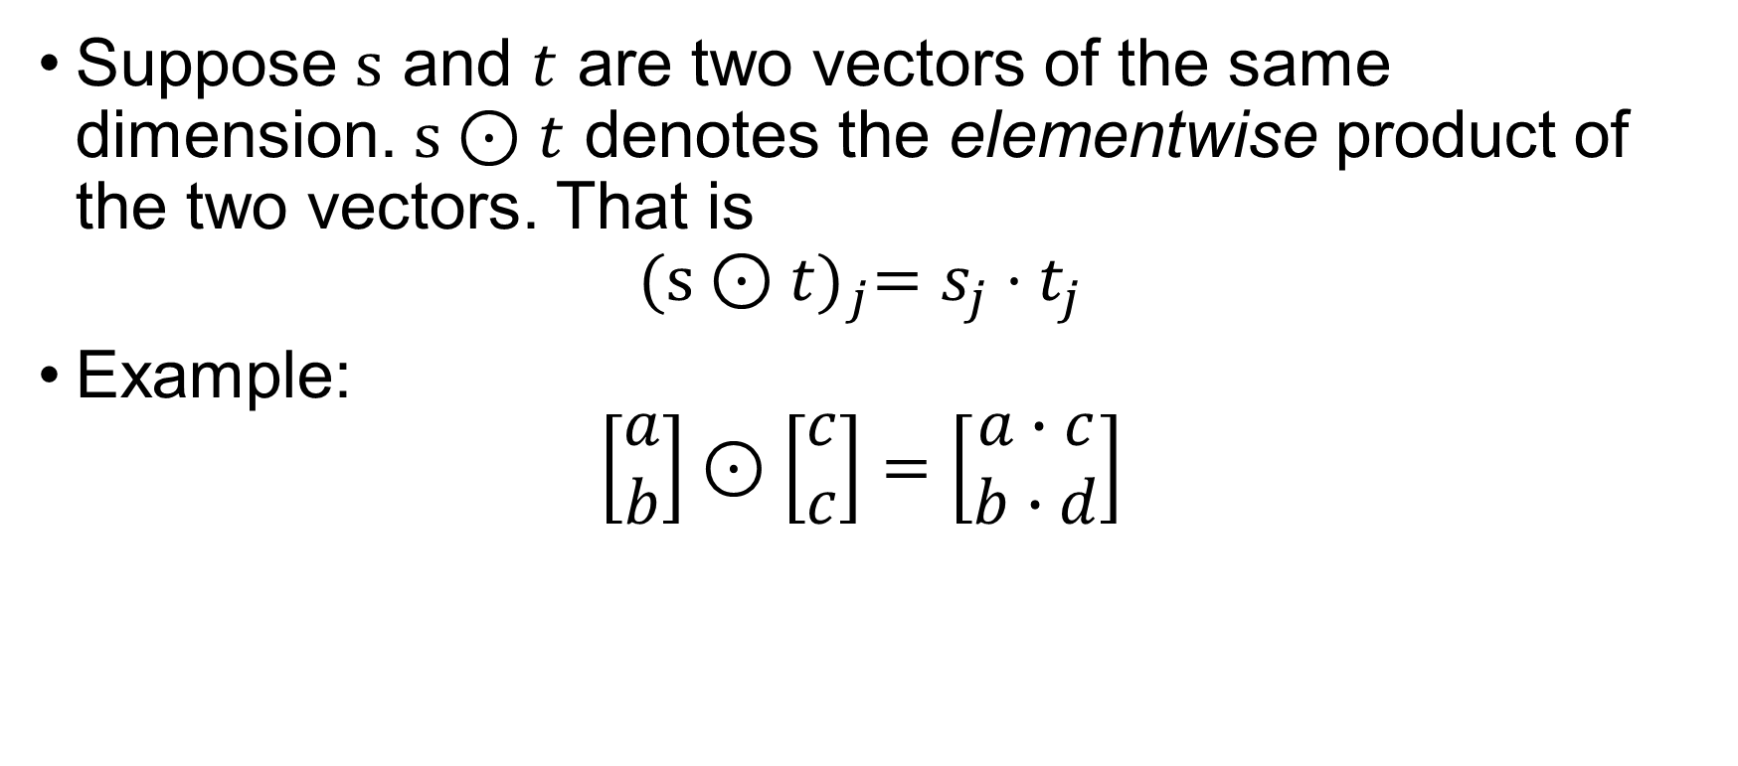

P3: The Hadamard product, $s⊙t$
Suppose $s$ and $t$ are two vectors of the same dimension. $s⊙t$ denotes the elementwise product of the two vectors. That is ${(s⊙t)}_{j}=s_{j}{⋅t}_{j}$
Example: $\left[\begin{matrix}a \\ b\end{matrix}\right]⊙\left[\begin{matrix}c \\ c\end{matrix}\right]=\left[\begin{matrix}a∙c \\ b∙d\end{matrix}\right]$

Slide 19
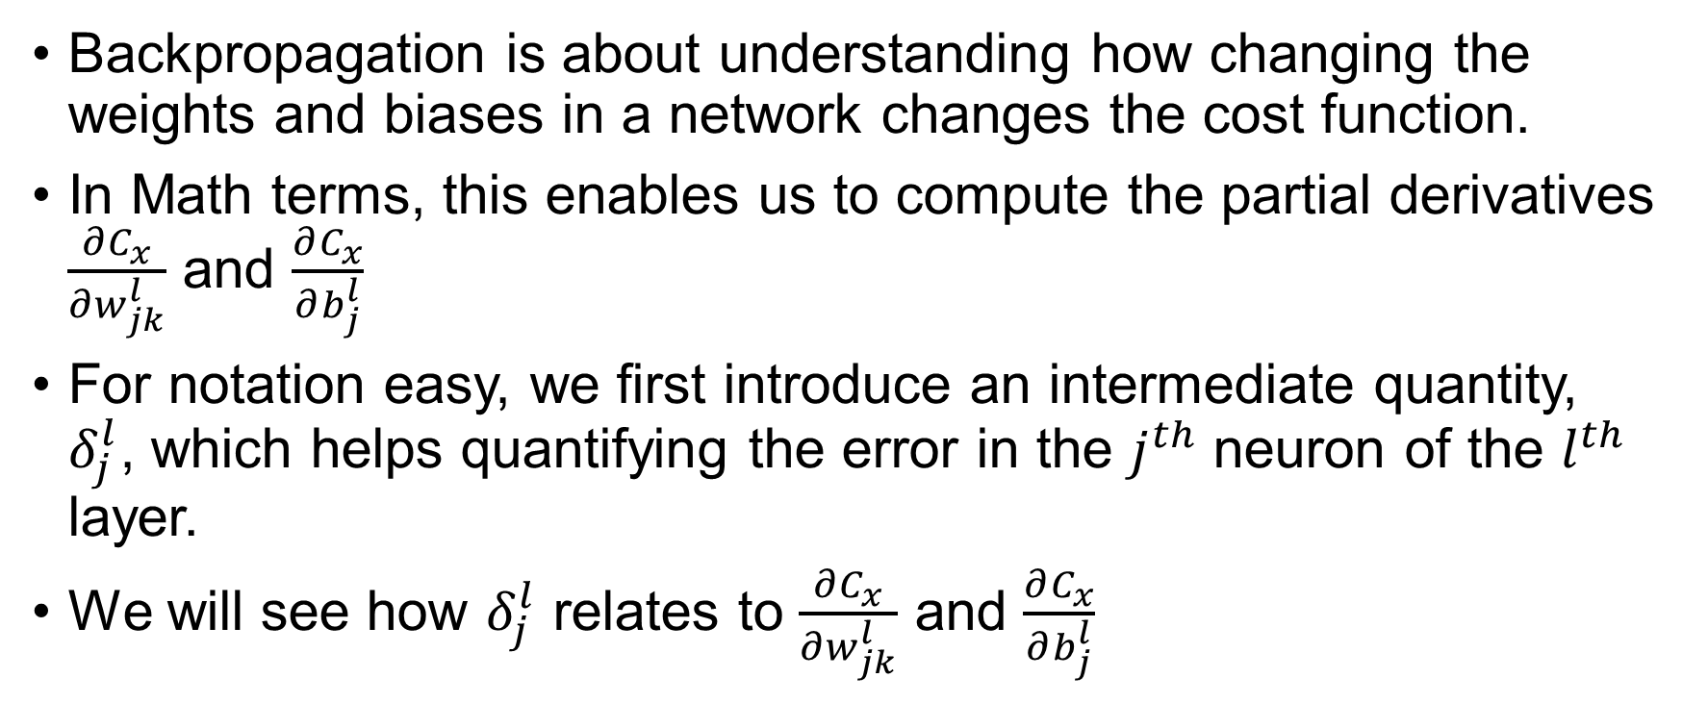
Backpropagation
Backpropagation is about understanding how changing the weights and biases in a network changes the cost function.
In Math terms, this enables us to compute the partial derivatives $\frac{∂C_{x}}{∂w_{jk}^{l}}$ and $\frac{∂C_{x}}{∂b_{j}^{l}}$
For notation easy, we first introduce an intermediate quantity, $δ_{j}^{l}$, which helps quantifying the error in the $j^{th}$ neuron of the $l^{th}$ layer.
We will see how $δ_{j}^{l}$ relates to $\frac{∂C_{x}}{∂w_{jk}^{l}}$ and $\frac{∂C_{x}}{∂b_{j}^{l}}$

Slide 20
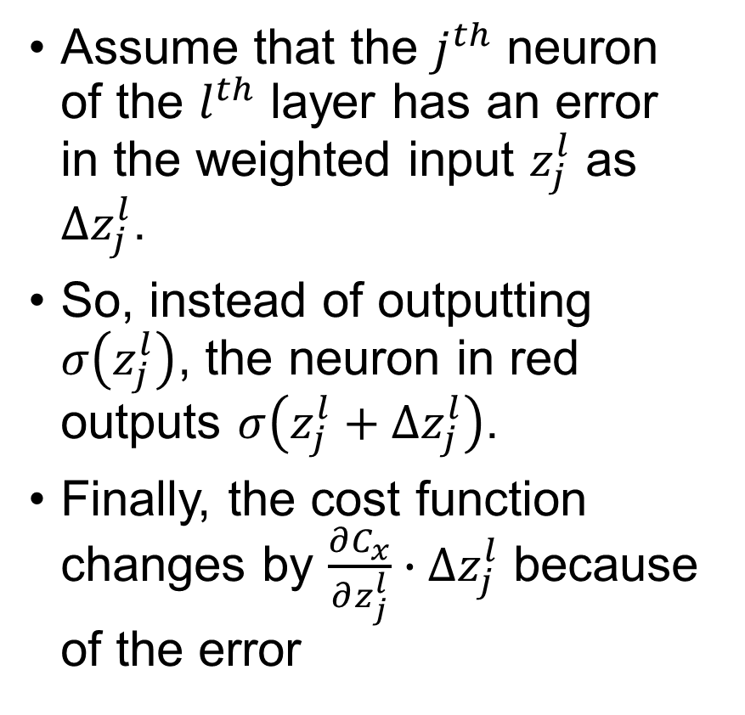
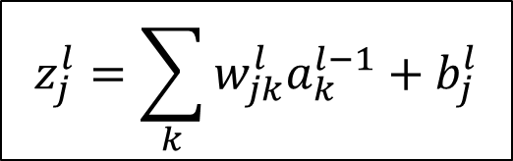


Backpropagation
$$a^{l}=σ\left(z^{l}\right)$$
$$z_{j}^{l}=\sum_{k}{w_{jk}^{l}a_{k}^{l−1}}+b_{j}^{l}$$
Assume that the $j^{th}$ neuron of the $l^{th}$ layer has an error in the weighted input $z_{j}^{l}$ as ${∆z}_{j}^{l}$.
So, instead of outputting $σ\left(z_{j}^{l}\right)$, the neuron in red outputs $σ\left(z_{j}^{l}+{∆z}_{j}^{l}\right)$.
Finally, the cost function changes by $\frac{∂C_{x}}{∂z_{j}^{l}}∙{∆z}_{j}^{l}$ because of the error
$${∆z}_{j}^{l}$$

Slide 21
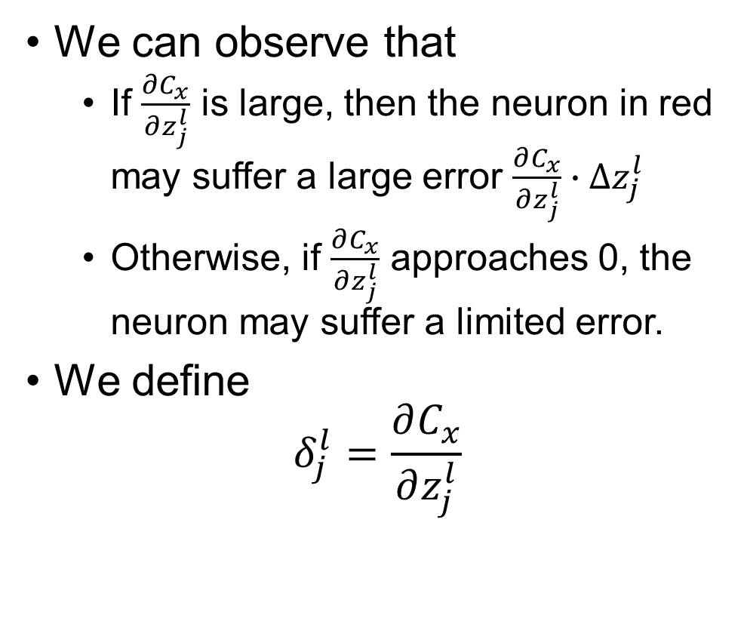
Backpropagation
$$a^{l}=σ\left(z^{l}\right)$$
$$z_{j}^{l}=\sum_{k}{w_{jk}^{l}a_{k}^{l−1}}+b_{j}^{l}$$
We can observe that
If $\frac{∂C_{x}}{∂z_{j}^{l}}$ is large, then the neuron in red may suffer a large error $\frac{∂C_{x}}{∂z_{j}^{l}}∙{∆z}_{j}^{l}$
Otherwise, if $\frac{∂C_{x}}{∂z_{j}^{l}}$ approaches 0, the neuron may suffer a limited error.
We define $δ_{j}^{l}=\frac{∂C_{x}}{∂z_{j}^{l}}$
$${∆z}_{j}^{l}$$

Slide 22

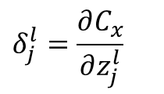

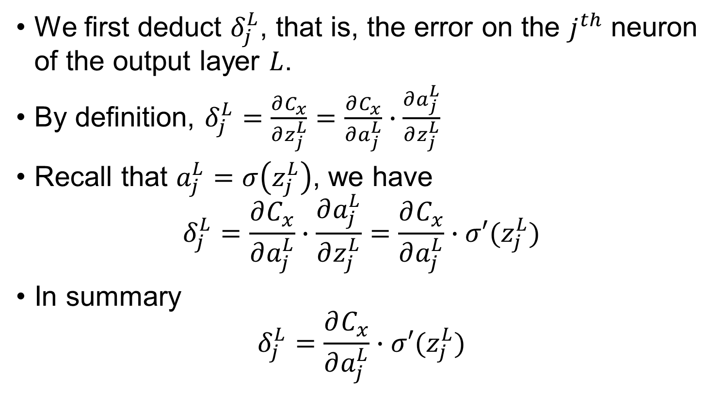


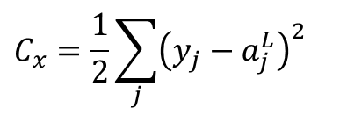

Backpropagation – Corollary 1
$$δ_{j}^{l}=\frac{∂C_{x}}{∂z_{j}^{l}}$$
We first deduct $δ_{j}^{L}$, that is, the error on the $j^{th}$ neuron of the output layer $L$.
By definition, $δ_{j}^{L}=\frac{∂C_{x}}{∂z_{j}^{L}}=\frac{∂C_{x}}{∂a_{j}^{L}}∙\frac{∂a_{j}^{L}}{∂z_{j}^{L}}$
Recall that $a_{j}^{L}=σ\left(z_{j}^{L}\right)$, we have $δ_{j}^{L}=\frac{∂C_{x}}{∂a_{j}^{L}}∙\frac{∂a_{j}^{L}}{∂z_{j}^{L}}=\frac{∂C_{x}}{∂a_{j}^{L}}∙σ′(z_{j}^{L})$
In summary $δ_{j}^{L}=\frac{∂C_{x}}{∂a_{j}^{L}}∙σ′(z_{j}^{L})$
$$C_{x}=\frac{1}{2}\sum_{j}{{\left(y_{j}−a_{j}^{L}\right)}^{2}}$$
Notice how we get ride of $\sum_{j}{ }$
$$a_{1}^{L}, y_{1}$$
$$a_{j}^{L}, y_{j}$$
$$σ\left(z_{j}^{L}\right)$$
$$a_{j}^{L}=σ\left(z_{j}^{L}\right)$$

Slide 23



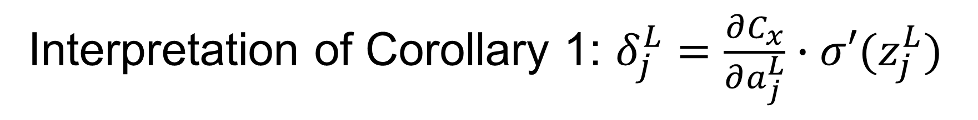


Interpretation of Corollary 1: $δ_{j}^{L}=\frac{∂C_{x}}{∂a_{j}^{L}}∙σ′(z_{j}^{L})$
The first term, $\frac{∂C_{x}}{∂a_{j}^{L}}$, measures how fast the cost is changing as a function of the $j^{th}$ output activation.
The second term, $σ′(z_{j}^{L})$, measures how fast the activation function $σ$ is changing at $z_{j}^{L}$.
Given $C_{x}=\frac{1}{2}\sum_{j}{{\left(y_{j}−a_{j}^{L}\right)}^{2}}$→ $\frac{∂C_{x}}{∂a_{j}^{L}}=\left(a_{j}^{L}−y_{j}\right)$
Given $σ\left(z_{j}^{L}\right)=\frac{1}{1+e^{−z_{j}^{L}}}$, $σ′\left(z_{j}^{L}\right)=$ $σ\left(z_{j}^{L}\right)∙\left(1−σ\left(z_{j}^{L}\right)\right)$
Given $z_{j}^{l}=\sum_{k}{w_{jk}^{l}a_{k}^{l−1}}+b_{j}^{l}$ $\frac{∂C_{x}}{∂w_{jk}^{L}}=δ_{j}^{L}∙a_{k}^{L−1}$
You can calculate $\frac{∂C_{x}}{∂b_{j}^{l}}$ following the same principle.
That’s how $δ_{j}^{L}$ relates to $\frac{∂C_{x}}{∂w_{jk}^{l}}$ and $\frac{∂C_{x}}{∂b_{j}^{l}}$
$$a_{1}^{L}, y_{1}$$
$$a_{j}^{L}, y_{j}$$
$$σ\left(z_{j}^{L}\right)$$

Slide 24
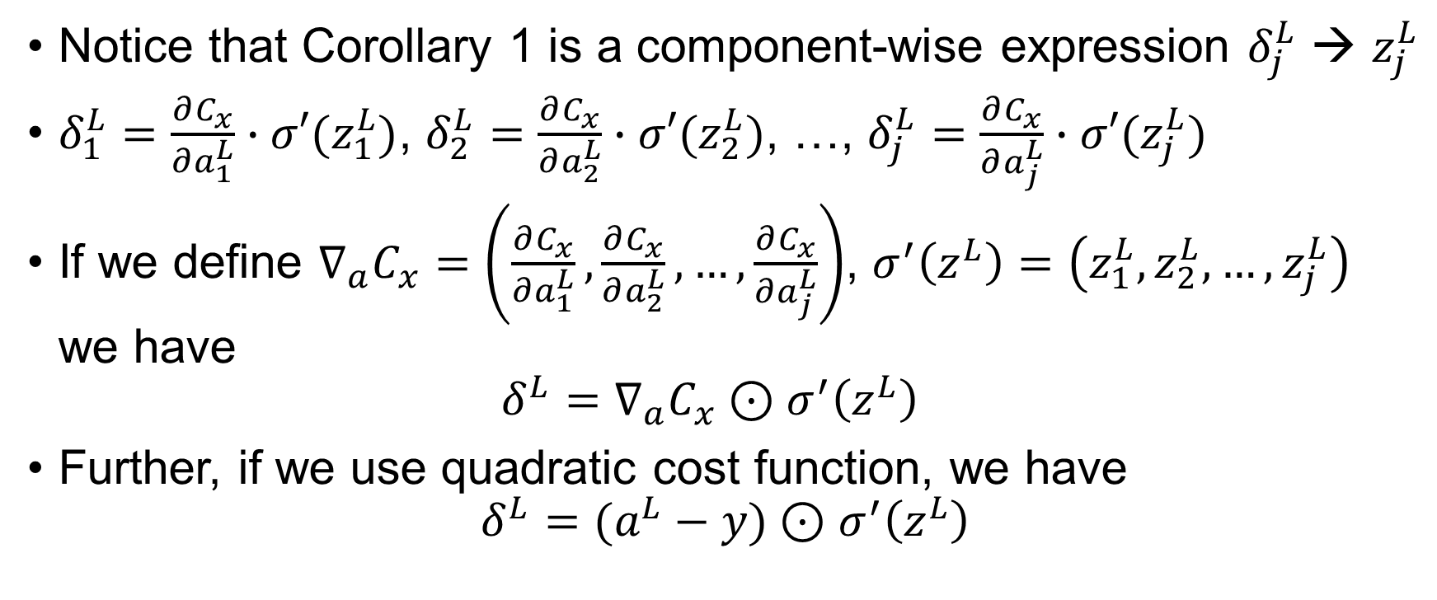
Interpretation of Corollary 1: $δ_{j}^{L}=\frac{∂C_{x}}{∂a_{j}^{L}}∙σ′(z_{j}^{L})$
Notice that Corollary 1 is a component-wise expression $δ_{j}^{L}$ → $z_{j}^{L}$
$δ_{1}^{L}=\frac{∂C_{x}}{∂a_{1}^{L}}∙σ′(z_{1}^{L})$, $δ_{2}^{L}=\frac{∂C_{x}}{∂a_{2}^{L}}∙σ′(z_{2}^{L})$, …, $δ_{j}^{L}=\frac{∂C_{x}}{∂a_{j}^{L}}∙σ′(z_{j}^{L})$
If we define $∇_{a}C_{x}=\left(\frac{∂C_{x}}{∂a_{1}^{L}},\frac{∂C_{x}}{∂a_{2}^{L}}, …,\frac{∂C_{x}}{∂a_{j}^{L}}\right)$, $σ^{′}\left(z^{L}\right)=\left(z_{1}^{L},z_{2}^{L}, …,z_{j}^{L}\right)$ we have $δ^{L}=∇_{a}C_{x}⊙σ^{′}\left(z^{L}\right)$
Further, if we use quadratic cost function, we have $δ^{L}=(a^{L}−y)⊙σ^{′}\left(z^{L}\right)$

Slide 25

Questions?

